Slide 1


PYTHON
Lecture 5

Slide 2

Today’s Agenda
Data Types
Basic Data Types In Python
Some Very Important Points To Remember
Numeric Types
Different Types Of Integers
Converting Between Int Types

Slide 3
Basic Data Types In Python
Although a programmer is not allowed to mention the data type while creating variables in his program in Python , but Python internally allots different data types to variables depending on their declaration style and values.
Overall Python has 14 data types and these are classified into 6 categories.

Slide 4
Basic Data Types In Python
These categories are:
Numeric Types
Boolean Type
Sequence Types
Set Types
Mapping Type
None Type
Given on the next slide are the names of actual data types belonging to the above mentioned categories

Slide 5
Basic Data Types In Python
Numeric Type | Boolean Type | Sequence Type | Set Type | Mapping Type | None Type
int | bool | str | set | dict | NoneType
float |  | list | frozenset
complex |  | bytes
 |  | bytearray
 |  | tuple
 |  | range

Slide 6
Some Very Important Points
Before we explore more about these data types , let us understand following important points regarding Python’s data types:
DATA TYPES IN PYTHON ARE DYNAMIC
SIZE OF THE DATA TYPE IS ALSO DYNAMICALLY MANAGED
DATA TYPES ARE UNBOUNDED

Slide 7
Some Very Important Points
DATA TYPES IN PYTHON ARE DYNAMIC
The term dynamic means that we can assign different values to the same variable at different points of time.
Python will dynamically change the type of variable as per the value given.

Slide 8
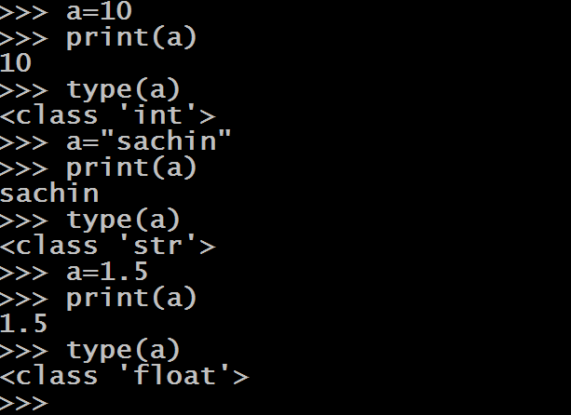
Some Very Important Points
type() is a built –in function and it returns the data type of the variable
Another important observation we can make is that in Python all the data types are implementted as classes and all variables are objects

Slide 9
Some Very Important Points
SIZE OF THE DATA TYPE IS ALSO DYNAMICALLY MANAGED
In Python the size of data types is dynamically managed
Like C/C++/Java language , variables in Python are not of fixed size.
Python makes them as big as required on demand
There is no question of how much memory a variable uses in Python because this memory increases as per the value being assigned

Slide 10
Some Very Important Points
Python starts with initial size for a variable and then increases its size as needed up to the RAM limit
This initial size for int is 24 bytes and then increases as the value is increased
If we want to check the size of a variable , then Python provides us a function called getsizeof() .
This function is available in a module called sys

Slide 11
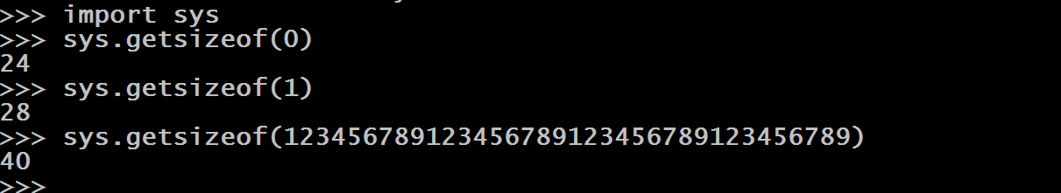
Some Very Important Points

Slide 12
Some Very Important Points
DATA TYPES ARE UNBOUNDED
Third important rule to remember is that , in Python data types like integers don’t have any range i.e. they are unbounded
Like C /C++ /Java they don’t have max or min value
So an int variable can store as many digits as we want.

Slide 13
Numeric Types In Python
As previously mentioned , Python supports 3 numeric types:
int: Used for storing integer numbers without any fractional part
float: Used for storing fractional numbers
complex: Used for storing complex numbers

Slide 14
Numeric Types In Python
EXAMPLES OF int TYPE:
a=10
b=256
c=-4
print(a)
print(b)
print(c)
Output:
10
256
-4

Slide 15
Numeric Types In Python
DIFFERENT WAYS OF REPRESENTING int IN PYTHON:
As decimal number( base 10)
As binary number( base 2)
As octal number(base 8)
As hexadecimal number( base 16)

Slide 16
Numeric Types In Python
REPRESENTING int AS DECIMAL( base 10) :
This is the default way of representing integers
The term base 10 means , 10 digits from 0 to 9 are allowed
Example:
a=25

Slide 17
Numeric Types In Python
REPRESENTING int AS BINARY( base 2) :
We can represent numeric values as binary values also
The term base 2 means , only 2 digits from 0 and 1 are allowed
But we need to prefix the number with 0b or 0B , otherwise Python will take it to be a decimal number

Slide 18
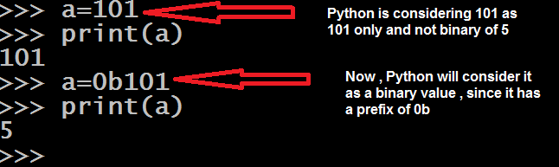
Numeric Types In Python

Slide 19

Some Very Important Observation
For representing binary value it is compulsory to prefix the number with 0b or 0B.
Although we can assign binary value to the variable but when we display it we always get output in decimal number system form.

Slide 20
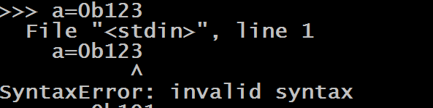
Some Very Important Observation
We cannot provide any other digit except 0 and 1 while giving binary value , otherwise Python will generate syntax error.

Slide 21

Some Very Important Observation
We can provide negative values in binary number system also by prefixing 0b with - .

Slide 22

Numeric Types In Python
REPRESENTING int AS OCTAL( base 8) :
We can represent numeric values as octal values also
The term base 8 means , only 8 digits from 0 to 7 are allowed
But we need to prefix the number with zero followed by small o or capital O i.e. either 0o or 0O , otherwise Python will take it to be a decimal number

Slide 23
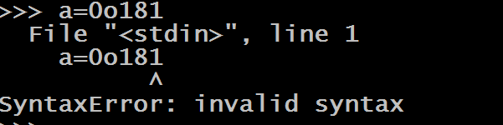
Numeric Types In Python
We cannot provide any other digit except 0 , 1 , 2 , 3 , 4 , 5 , 6 and 7 while giving octal value , otherwise Python will generate syntax error.

Slide 24

Numeric Types In Python
Just like binary number system , we can provide negative values in octal number system also by prefixing 0O with -

Slide 25

Numeric Types In Python
REPRESENTING int AS HEXADECIMAL( base 16) :
We can represent numeric values as hexadecimal values also
The term base 16 means , only 16 digits from 0 to 9 , a to f and A to F are allowed
But we need to prefix the number with zero followed by small x or capital X i.e. either 0x or 0X , otherwise Python will take it to be a decimal number

Slide 26
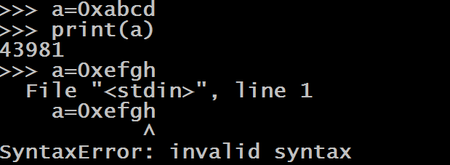
Numeric Types In Python
We cannot provide any other value except the digits and characters from A to F while giving hexadecimal value , otherwise Python will generate syntax error.

Slide 27

Numeric Types In Python
Just like other number systems , we can provide negative values in hexadecimal number system also by prefixing 0x with -

Slide 28
Base Conversion Functions
We know that Python allows us to represent integer values in 4 different forms like int , binary , octal and hexadecimal
Moreover it also allows us to convert one base type to another base type with the help of certain functions.
These functions are:
bin()
oct()
hex()

Slide 29
The bin( ) Function
The bin() function converts and returns the binary equivalent of a given integer.
Syntax : bin(a)
Parameters : a : an integer to convert . This value can be of type decimal , octal or hexadecimal
Return Value : A string representing binary value

Slide 30


The bin( ) Function
Some Examples:
Converting decimal base to binary
Converting octal base to binary

Slide 31

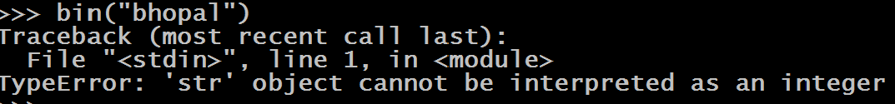
The bin( ) Function
Some Examples:
Converting hexadecimal base to binary
Error if the value passed is not an integer

Slide 32
The oct( ) Function
The oct() function converts and returns the octal equivalent of a given integer.
Syntax : oct(a)
Parameters : a : an integer to convert . This value can be of type decimal , binary or hexadecimal
Return Value : A string representing octal value

Slide 33


The oct( ) Function
Some Examples:
Converting decimal base to octal
Converting binary base to octal

Slide 34

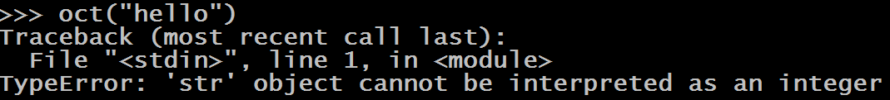
The oct( ) Function
Some Examples:
Converting hexadecimal base to octal
Error if the value passed is not an integer

Slide 35
The hex( ) Function
The hex() function converts and returns the hexadecimal equivalent of a given integer.
Syntax : hex(a)
Parameters : a : an integer to convert . This value can be of type decimal , octal or bin
Return Value : A string representing hexadecimal value

Slide 36


The hex( ) Function
Some Examples:
Converting decimal base to hexadecimal
Converting binary base to hexadecimal

Slide 37

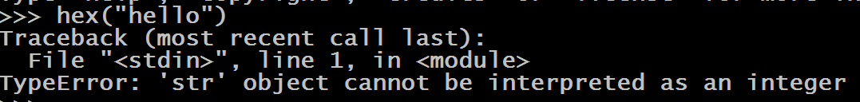
The hex ( ) Function
Some Examples:
Converting octal base to hexadecimal
Error if the value passed is not an integer

